Slide 1
Beyond Deep Learning: Synthesizing Navigation Programs using Neural Turing Machines
By Sarah Martin
Supervised by Dr. Heni Ben Amor
Arizona State University

Slide 2
Goal
Improve the navigation accuracy of self-driving cars
Problem
  Cars currently do not have long-term memory to learn from previous trips
Solution
  Enhance the navigation system using a different kind of neural network, Neural Turing Machine, to add memory

Slide 3
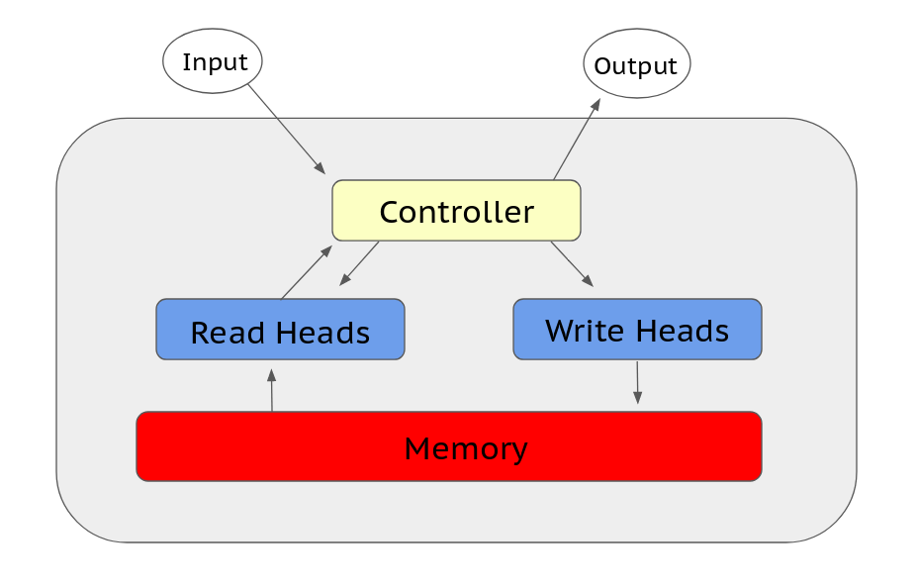
What is a Neural Turing Machine?
A Neural Turing Machine (NTM) is a neural network with an external memory structure.

Slide 4
Methods
Test if the NTM structure is effective on a simple task
Implement a NTM to control a simulated autonomous car
All experiments were written in Python, utilizing machine learning frameworks TensorFlow and PyTorch.

Slide 5
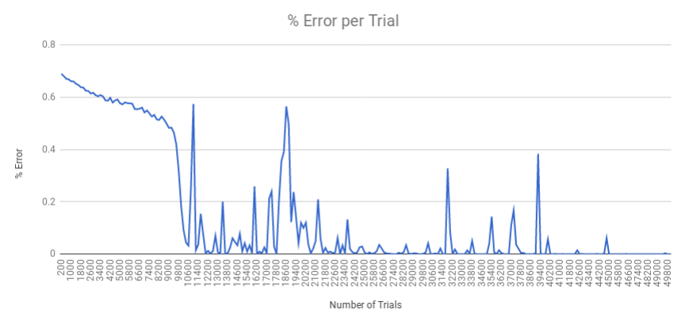
NTM Efficiency for Palindromes
Learning how to make palindromes from bit sequences
50,000 trials for training
100% accuracy
0 0 1 0 0 0 1 0
0 0 1 0 0 0 1 0 0 1 0 0 0 1 0 0
Notes:
The average % error for every 200 trials

Slide 6
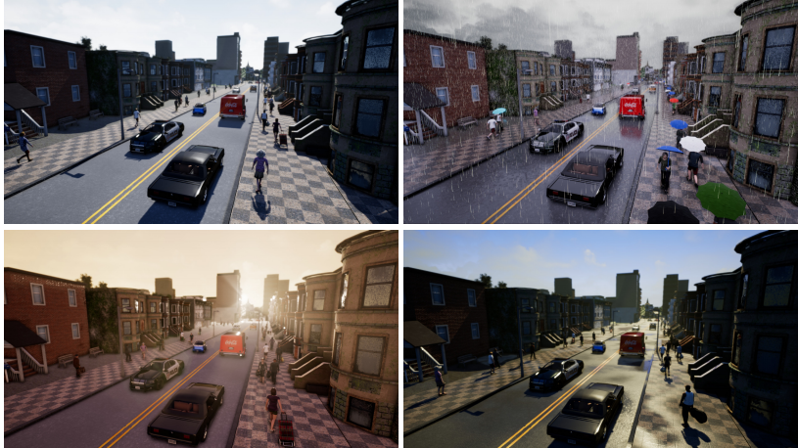
NTM Efficiency for Car Navigation
Using open-source car simulator CARLA, the car was trained to take a right turn at the first intersection it encountered.
www.carla.org

Slide 7
Conclusion
The NTM structure was proved useful, as it was able to learn different tasks, sometimes with 100% accuracy.
We hope to apply this to learning more complex tasks, like collision prediction.

Slide 8
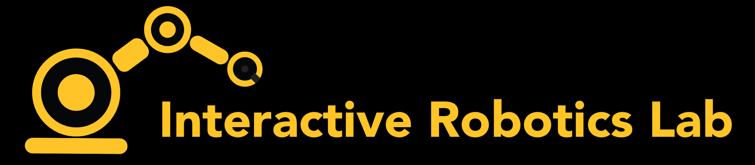

Special Thanks To...

Slide 9

Questions?

